Slide 1
SIMS
PH1102E/GEK1067
Week 11

Slide 2


Slide 3



Slide 4








Slide 5
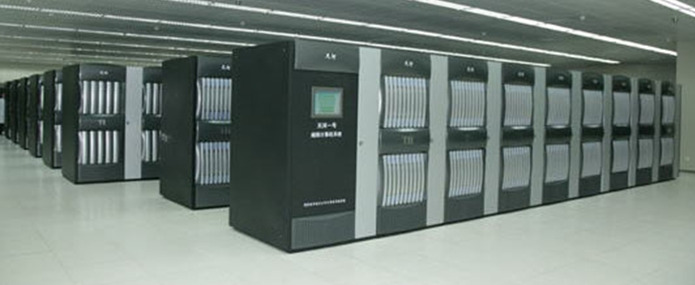
Earth History Simulator

Slide 6
Earth History Simulator
Claim: the Earth History Simulator generates real human experiences (or experiences indistinguish-able from those that ordinary human beings actually have).

Slide 7
Earth History Simulator
Claim: the Earth History Simulator generates real human experiences (or experiences indistinguish-able from those that ordinary human beings actually have).
Objection: conscious experience can’t arise from a mere computer!

Slide 8
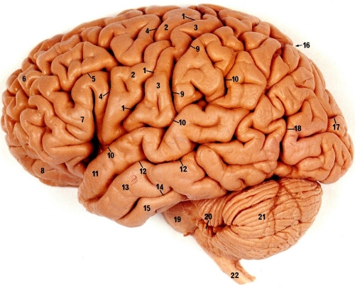

Slide 9
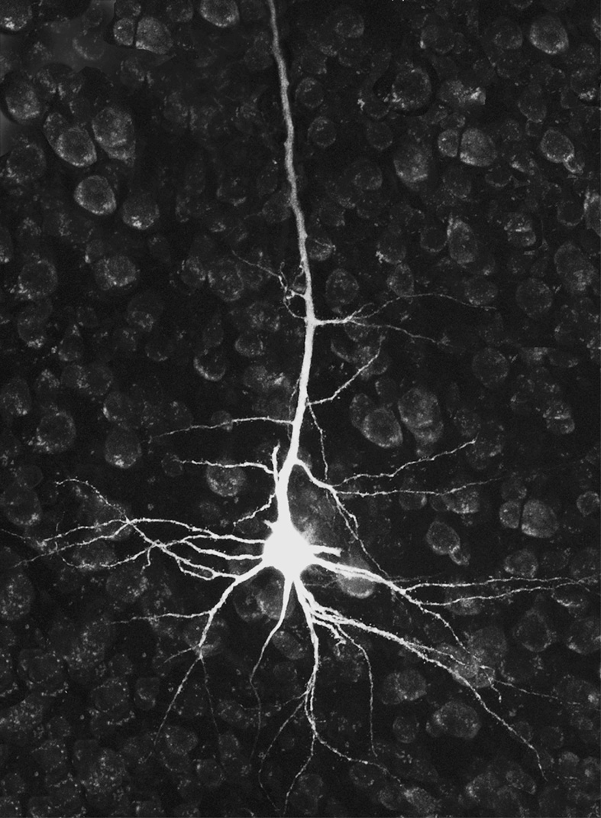

Slide 10
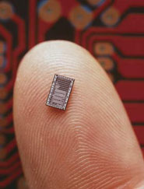

Slide 12
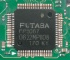

Slide 16
Earth History Simulator
Claim: the Earth History Simulator generates real human experiences (or experiences indistinguish-able from those that ordinary human beings actually have).
Objection: conscious experience can’t arise from a mere computer!

Slide 17
Earth History Simulator
Claim: the Earth History Simulator generates real human experiences (or experiences indistinguish-able from those that ordinary human beings actually have).
Objection: conscious experience can’t arise from a mere computer!

Slide 18
Earth History Simulator
Claim: the Earth History Simulator generates real human experiences (or experiences indistinguish-able from those that ordinary human beings actually have).
Objection: conscious experience can’t arise from a mere computer!
Objection: a high-speed simulation would generate high-speed experiences!

Slide 19



Slide 20
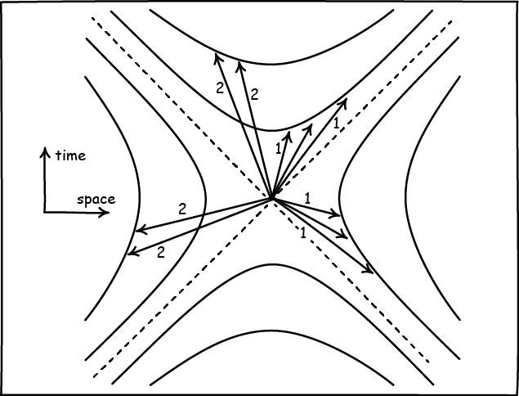
In relativistic spacetime, any process can be correctly described as having any duration.
This includes your own conscious mental processes.
So the fact that the Earth History Simulator as generating conscious experiences at a vastly accelerated rate doesn’t affect the quality of the experiences it generates.

Slide 21
Earth History Simulator
Claim: the Earth History Simulator generates real human experiences (or experiences indistinguish-able from those that ordinary human beings actually have).
Objection: conscious experience can’t arise from a mere computer!
Objection: a high-speed simulation would generate high-speed experiences!

Slide 22
Earth History Simulator
Claim: the Earth History Simulator generates real human experiences (or experiences indistinguish-able from those that ordinary human beings actually have).
Objection: conscious experience can’t arise from a mere computer!
Objection: a high-speed simulation would generate high-speed experiences!

Slide 23
OK, but this is all just fantasy.
We have no reason to think that anyone has ever actually built an Earth History Simulator.

Slide 24
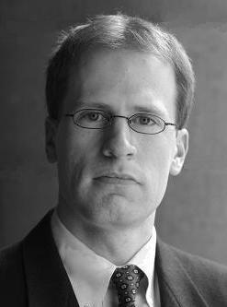
Nick Bostrom, Futurologist

Slide 25
Don’t be so sure about that!
Nick Bostrom, Futurologist

Slide 26
Simulation Argument
It is likely that humans develop Earth History Simulation technology at some point in time.
If humans do develop such technology, it is likely that they will use the Simulators to generate a vast number of (computer-based) Earthlike mental lives.
So, it is likely that humans generate a vast number of computer-based Earthlike mental lives at some point in time. (from 1, 2)
Notes:
Unless civilizations like ours tend to go extinct before achieving this kind of technology…
Or decide not to use the technology to create Sims..

Slide 27
It is likely that humans develop Earth History Simulation technology at some point in time.
How powerful would a computer have to be to reproduce the mental activity of a human brain?
Well, your brain can perform 10¹⁷ operations per second (or “flops”).
Today’s most powerful computers are capable of only 10¹⁶ flops.

Slide 28
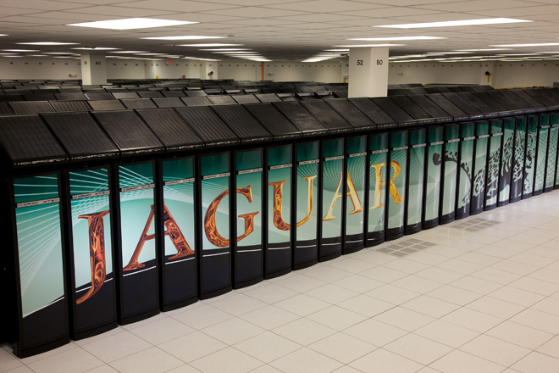


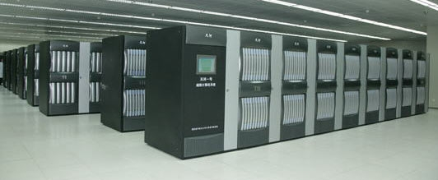
Berkeley Open Infrastructure for Network Computing
Cray Jaguar
Tianhe-I
Folding@home

Slide 29


Slide 30

IBM is currently building a computer that will be capable of 10¹⁸ flops:
IBM Exaflop Machine
(c. 2020)
Your Brain
10¹⁸ flops
10¹⁷ flops

Slide 31

IBM is currently building a computer that will be capable of 10¹⁸ flops:
IBM Exaflop Machine
(c. 2020)
Your Brain
10¹⁸ flops
10¹⁷ flops

Slide 32
It is likely that humans develop Earth History Simulation technology at some point in time.
In fact, using only currently available technology, we could---given enough time, effort, and Sony PlayStations---build a computer capable of performing 10⁴² operations per second.
Such a computer would be powerful enough to digitally reproduce all of the activity that has taken place in human brains from the emergence of our species until the present day, in one one-millionth of a second.
Notes:
See, e.g., Bostrom.

Slide 33
It is likely that humans develop Earth History Simulation technology at some point in time.
“Yeah, but what are the chances that human beings will ever construct such a powerful computer?”

Slide 34
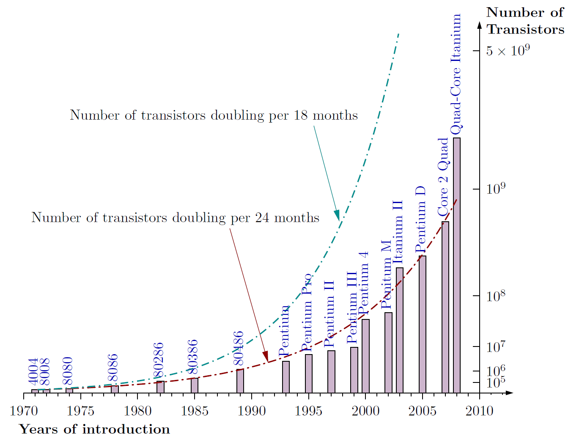
Moore’s Law

Slide 35
Simulation Argument
It is likely that humans develop Earth History Simulation technology at some point in time.
If humans do develop such technology, it is likely that they will use the Simulators to generate a vast number of (computer-based) Earthlike mental lives.
So, it is likely that humans generate a vast number of computer-based Earthlike mental lives at some point in time. (from 1, 2)
Notes:
Unless civilizations like ours tend to go extinct before achieving this kind of technology…
Or decide not to use the technology to create Sims..

Slide 36
Simulation Argument
It is likely that humans develop Earth History Simulation technology at some point in time.
If humans do develop such technology, it is likely that they will use the Simulators to generate a vast number of (computer-based) Earthlike mental lives.
So, it is likely that humans generate a vast number of computer-based Earthlike mental lives at some point in time. (from 1, 2)
Notes:
Unless civilizations like ours tend to go extinct before achieving this kind of technology…
Or decide not to use the technology to create Sims..

Slide 37
If humans do develop such technology, it is likely that they will use the Simulators to generate a vast number of (computer-based) Earthlike mental lives.

Slide 38
If humans do develop such technology, it is likely that they will use the Simulators to generate a vast number of (computer-based) Earthlike mental lives.
Virtual history tours ($$$)
Gaming applications ($$$$)
Testing historical hypotheses

Slide 39
If humans do develop such technology, it is likely that they will use the Simulators to generate a vast number of (computer-based) Earthlike mental lives.
Virtual history tours ($$$)
Gaming applications ($$$$)
Testing historical hypotheses

Slide 40
If humans do develop such technology, it is likely that they will use the Simulators to generate a vast number of (computer-based) Earthlike mental lives.
Virtual history tours ($$$)
Gaming applications ($$$$)
Testing historical hypotheses

Slide 41
Simulation Argument
It is likely that humans develop Earth History Simulation technology at some point in time.
If humans do develop such technology, it is likely that they will use the Simulators to generate a vast number of (computer-based) Earthlike mental lives.
So, it is likely that humans generate a vast number of computer-based Earthlike mental lives at some point in time. (from 1, 2)
Notes:
Unless civilizations like ours tend to go extinct before achieving this kind of technology…
Or decide not to use the technology to create Sims..

Slide 42
Assuming that mankind at some point develops this kind of technology, the number of computerized or “simulated” mental lives that ever exist far exceeds the number of non-computerized mental lives that ever exist.

Slide 43
All the non-computer-generated humanlike mental lives that ever exist
All the humanlike mental lives that ever exist

Slide 44
Conclusion
There’s a decent chance that we are living in a computer simulation!

Slide 45
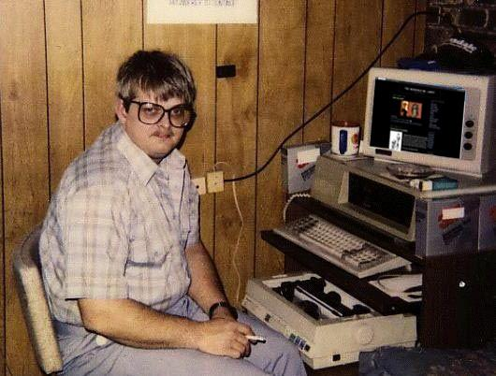
Meet your Maker?

Slide 46
End of lecture.

